Slide 1
B.Tech Integrated Final Presentation (Even Sem) A.Y. 2021-2022 Project Title : Disease Prediction System using Machine Learning
Presented by : Vaibhav Raheja (C056)
Viraj Shah (C064)
Mayank Shetty (C075)
Purav Patel (C098)
Under the guidance of : Prof. Manisha Tiwari

Slide 2
Roadmap
Introduction
Problem definition
Literature Review / Market Survey
Proposed System/ Algorithms /Architecture
Design Diagrams
Implementation and Result Discussion
Conclusion and Future Work
References

Slide 3
Introduction
Chronic diseases last for a period of 1 year or more, and are caused by environmental, genetic, and physiological factors.
Cardiovascular Disease is the leading cause of death globally, claiming an estimated 17.9 million lives in 2019 alone.
Respiratory disease, diabetes, and kidney diseases are included in the global list of top ten leading causes of death.
Early diagnosis of chronic diseases may reduce several casualties.

Slide 4
Problem Statement
During the COVID-19 Pandemic, several hospitals faced a severe shortage of highly-skilled doctors.
The ones who were available at times required an expert system, to help them aid in diagnosing a patient’s condition.
However, these expert systems may be much more useful, if they could personalise the diagnosis for each and every patient, with the help of an available doctor.

Slide 5
Literature Review
Link for Literature Review

Slide 6
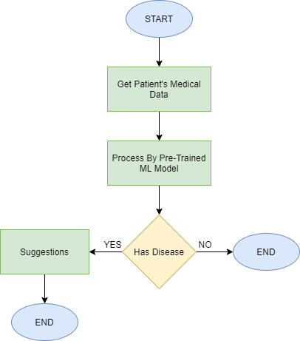
Proposed System
Chronic Disease | Dataset
Chronic Kidney Disease | UCI Chronic Kidney Disease Dataset
Diabetes | PIMA Indians Diabetes Database
Heart Ailments | UCI Heart Disease Dataset
Pneumonia | COVID-QU-Ex Dataset

Slide 7
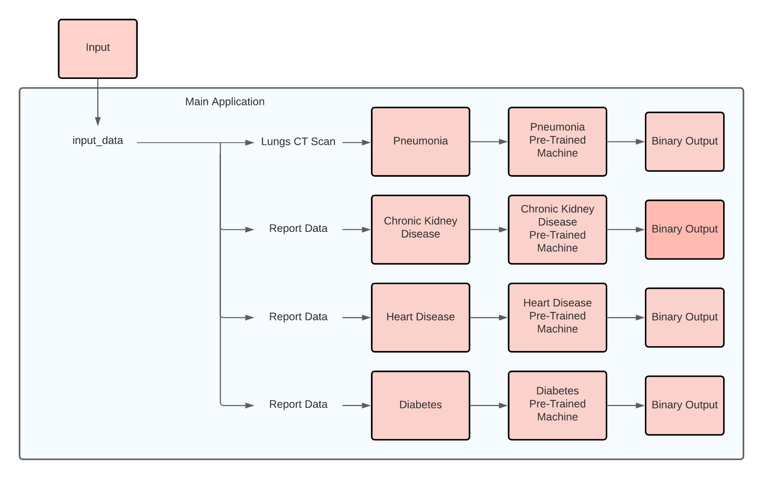
Architecture Diagram

Slide 8
Implementation (To Date)
Link for Live Implementation

Slide 9
Conclusion
Expert systems in medication are characterized as systems with the capacity to catch and store expert information, realities, and thinking strategies to assist doctors in diagnosing a patient's condition.
Our project incorporates the core aspects of an expert system by assisting doctors in the early diagnosis of a chronic disease in their patients through the use of trained machine learning models that provide high accuracy in detection.

Slide 10
Future work
We plan to take this project ahead by implementing model to predict other chronic disease therefore expanding the reach of the project.
We would further more like to improve the validation of each of these models by collecting live data and collaborating with medical professional and hospitals.
A future step would be to take the project open source and have community development for increasing the projects reach and give back to the community.

Slide 11
References
[1] J. J. Khanam, S. Y. Foo, “A comparison of machine learning algorithms for diabetes prediction”, ICT Express (Feb. 2021), 2021, doi: 10.1016/J.ICTE.2021.02.004.
[2] D. Shetty, K. Rit, S. Shaikh and N. Patil, "Diabetes disease prediction using data mining," 2017 International Conference on Innovations in Information, Embedded and Communication Systems (ICIIECS), 2017, pp. 1-5, doi: 10.1109/ICIIECS.2017.8276012.
[3] A. Mujumdar, V. Vaidehi, “Diabetes Prediction using Machine Learning Algorithms”, Procedia Computer Science, Volume 165, 2019, pp. 292-299, doi: 10.1016/J.PROCS.2020.01.047.
[4] S. K. Dey, A. Hossain and M. M. Rahman, "Implementation of a Web Application to Predict Diabetes Disease: An Approach Using Machine Learning Algorithm," 2018 21st International Conference of Computer and Information Technology (ICCIT), 2018, pp. 1-5, doi: 10.1109/ICCITECHN.2018.8631968.
[5] M. Kavitha, G. Gnaneswar, R. Dinesh, Y. R. Sai and R. S. Suraj, "Heart Disease Prediction using Hybrid Machine Learning Model," 2021 6th International Conference on Inventive Computation Technologies (ICICT), 2021, pp. 1329-1333, doi: 10.1109/ICICT50816.2021.9358597.
[6] F. Alotaibi, “Implementation of Machine Learning Model to Predict Heart Failure Disease”, International Journal of Advanced Computer Science and Applications (IJACSA), 10(6), 2019, doi: 10.14569/IJACSA.2019.0100637.
[7] J. Qin, L. Chen, Y. Liu, C. Liu, C. Feng and B. Chen, "A Machine Learning Methodology for Diagnosing Chronic Kidney Disease," in IEEE Access, vol. 8, pp. 20991-21002, 2020, doi: 10.1109/ACCESS.2019.2963053.
[8] R. Gupta, N. Koli, N. Mahor and N. Tejashri, "Performance Analysis of Machine Learning Classifier for Predicting Chronic Kidney Disease," 2020 International Conference for Emerging Technology (INCET), 2020, pp. 1-4, doi: 10.1109/INCET49848.2020.9154147.
[9] F. M. Javed Mehedi Shamrat, P. Ghosh, M. H. Sadek, M. A. Kazi and S. Shultana, "Implementation of Machine Learning Algorithms to Detect the Prognosis Rate of Kidney Disease," 2020 IEEE International Conference for Innovation in Technology (INOCON), 2020, pp. 1-7, doi: 10.1109/INOCON50539.2020.9298026.
[10] D. Varshni, K. Thakral, L. Agarwal, R. Nijhawan and A. Mittal, "Pneumonia Detection Using CNN based Feature Extraction," 2019 IEEE International Conference on Electrical, Computer and Communication Technologies (ICECCT), 2019, pp. 1-7, doi: 10.1109/ICECCT.2019.8869364. [11] A. Sharma, M. Negi, A. Goyal, R. Jain and P. Nagrath, “Detection of Pneumonia using ML & DL in Python.”, IOP Conference Series: Materials Science and Engineering 1022, 2021, doi: 10.1088/1757-899X/1022/1/012066.

